Slide 1
Our Continued Journey toward Data Interoperability
http://bit.ly/JourneyTowardInterop

Slide 2




Hello!
I am Chantell Manahan
I am the Technology Director at MSD of Steuben County in Angola, IN.
You can find me at @leadlaughlearn cmanahan@msdsc.us

Slide 3
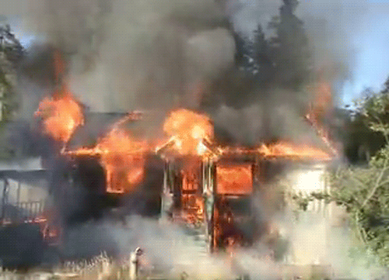
Curriculum/Testing Platforms

Slide 4

SIS Transition/
All that Data!

Slide 5

the seamless, secure and controlled exchange of data between different applications and technologies

Slide 6

IDOE LINK Initiative

Slide 7

Where are we? Take the Quiz!

Slide 8
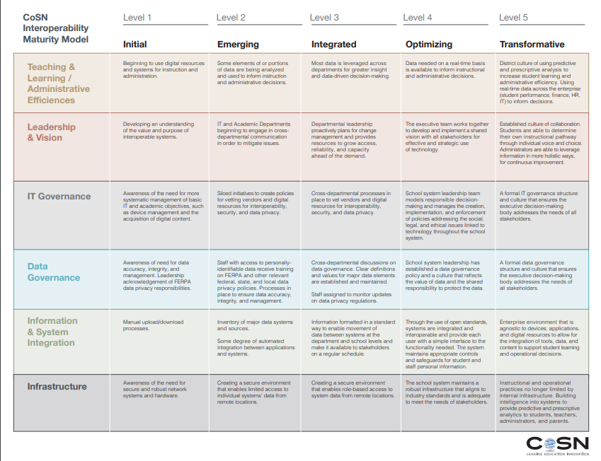

Slide 9







Slide 10
Eight Key Areas of Interoperability Standards
Digital Content
Data Connectivity
Data Integration
Authentication, Authorization, and Identity Management
Portals and Portlets
File Sharing
Network Infrastructure
Digital Accessibility

Slide 11
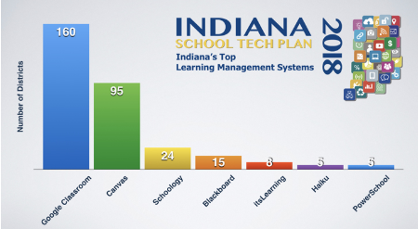
Digital Content

Slide 12
MSD of Steuben County Instructional Materials Adoption Guidelines
MSD of Wayne Township Guide and Flow Chart

Slide 13

Authentication, Authorization,
and identity Management
Rostering and SSO

Slide 14
More Resources
What Does It Take to Make Data Interoperability Work in K-12 Education?
Lack of Clear Standards, and Money, Trips Up District Tech Leaders on Interoperability
Unchaining Digital Data: K-12 Interoperability
Even for Districts Leading Interoperability Push, journey Is Just Beginning

